Slide 1
Back to Office – Technical Details
31-03-2020

Slide 2
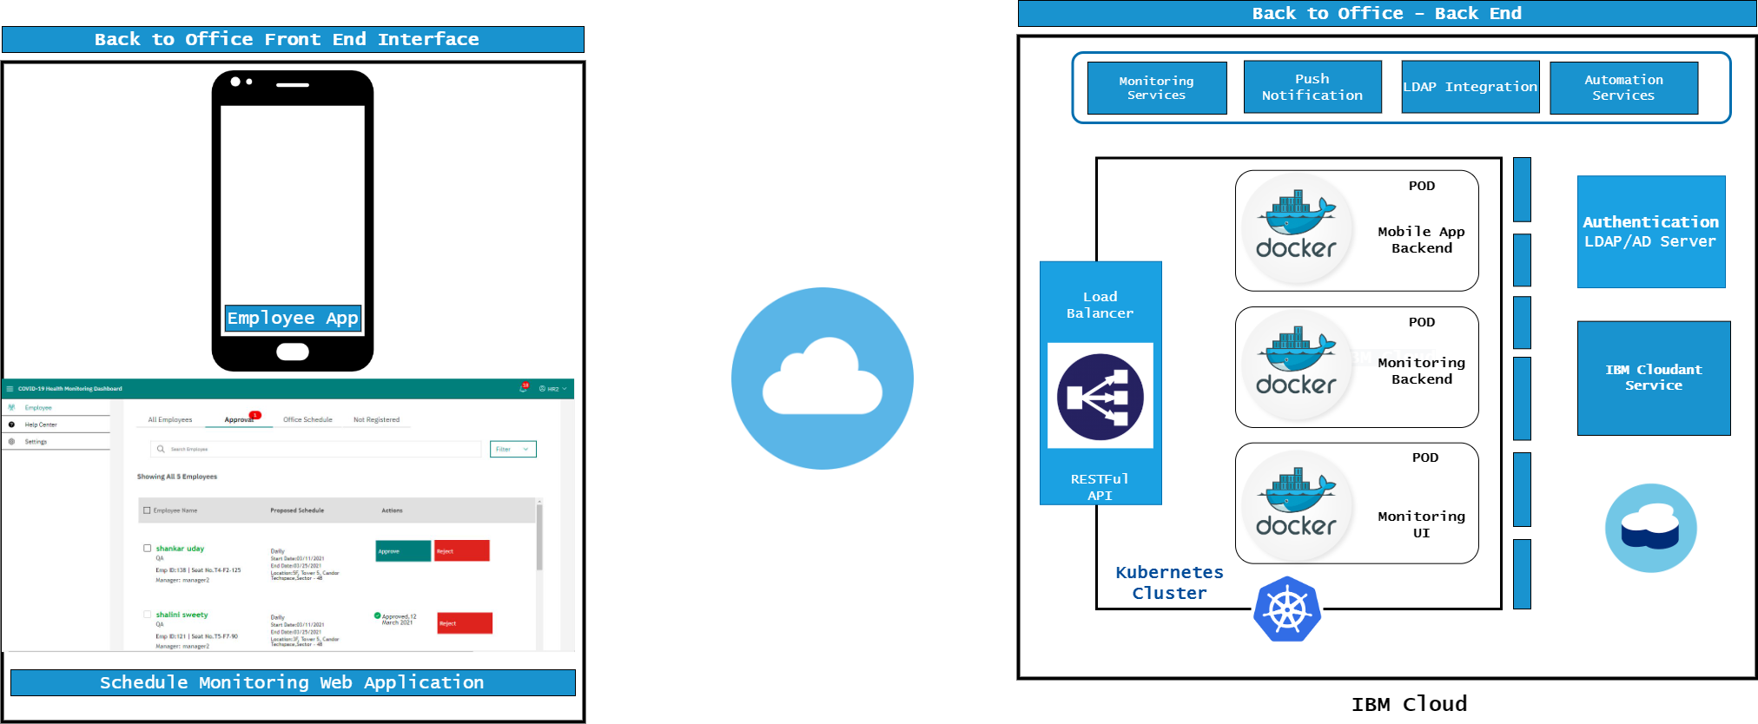
Product Architecture – “Back to Office”
Insights - BTO

Slide 3
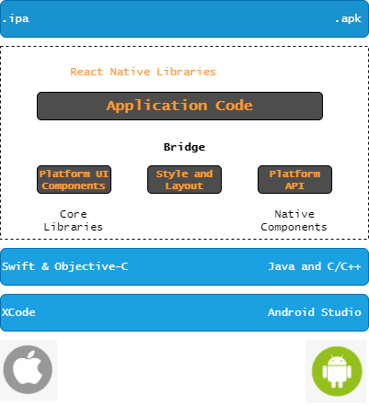
Layered Architecture – “Back to Office” Mobile App
Native App
Development Tools Visual Studio, Yarn and NPM Package Android Studio and Xcode
Security Scans Tools
Blackduck – OSS Analyzer
Coverity – Static Code Analysis
Languages
Tools

Slide 4
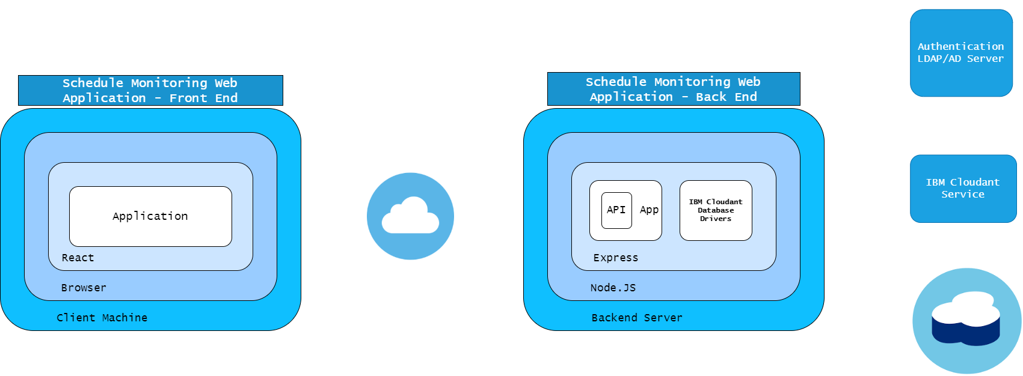
Layered Architecture – “Back to Office” Monitoring Side
Development Tools Visual Studio, Yarn and NPM Package
Security Scans Tools
Blackduck – OSS Analyzer
Coverity – Static Code Analysis

Slide 5
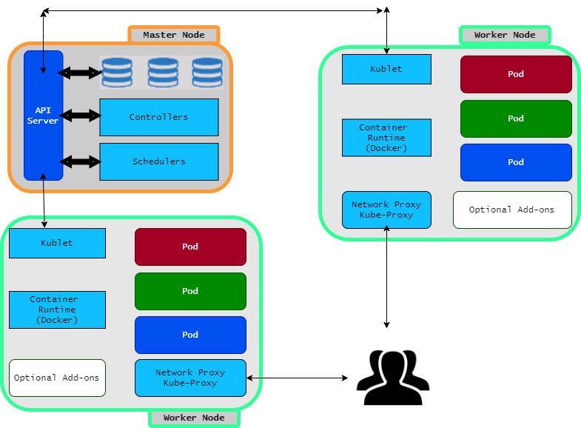
Deployment Diagram– “Back to Office”
Legends
Monitoring Interface Backend
Monitoring Interface
Mobile App Back End

Slide 6
POD/Services/Deployement – BTO
areyouwell@k8s-terminal ~ (⎈ mycluster-b2o/c04ra32d0i01c39cd8lg:default)$ kubectl get all
NAME READY STATUS RESTARTS AGE
pod/cfcaltran2020-6d5b74fd8c-gh2n4 1/1 Running 0 15d
pod/cfcaltranmonitor-5dc457685b-jj5k9 1/1 Running 0 15d
pod/cfcaltranmonitorui-5c7667d876-bgbc2 1/1 Running 0 15d
NAME TYPE CLUSTER-IP EXTERNAL-IP PORT(S) AGE
service/cfcaltran2020-service NodePort 172.21.97.221 <none> 8080:32607/TCP 63d
service/cfcaltranmonitor-service NodePort 172.21.88.206 <none> 8080:30640/TCP 63d
service/cfcaltranmonitorui-service NodePort 172.21.56.70 <none> 8080:30352/TCP 63d
service/kubernetes ClusterIP 172.21.0.1 <none> 443/TCP 63d
NAME READY UP-TO-DATE AVAILABLE AGE
deployment.apps/cfcaltran2020 1/1 1 1 63d
deployment.apps/cfcaltranmonitor 1/1 1 1 63d
deployment.apps/cfcaltranmonitorui 1/1 1 1 63d
NAME DESIRED CURRENT READY AGE
replicaset.apps/cfcaltran2020-6d5b74fd8c 1 1 1 63d
replicaset.apps/cfcaltranmonitor-5dc457685b 1 1 1 63d
replicaset.apps/cfcaltranmonitorui-5c7667d876 1 1 1 63d

Slide 7
POD/Services/Deployement – AYWA
areyouwell@k8s-terminal ~ (⎈ qacluster_aywa/bs1nu4cd09mce7ojq3hg:default)$ kubectl get all
NAME READY STATUS RESTARTS AGE
pod/cfc-monitoring-backend-qa-7db7f9f789-8w2vs 1/1 Running 1 217d
pod/cfc-monitoring-backend-qa-7db7f9f789-9bvsn 1/1 Running 1 217d
pod/cfc-monitoring-ui-qa-bc4cddb98-mkjwh 1/1 Running 0 217d
pod/cfc-monitoring-ui-qa-bc4cddb98-nwg4x 1/1 Running 0 217d
pod/cfc-patient-backend-qa-69cb9b77b8-2jjvk 1/1 Running 0 217d
pod/cfc-patient-backend-qa-69cb9b77b8-f8rq2 1/1 Running 0 217d
NAME TYPE CLUSTER-IP EXTERNAL-IP PORT(S) AGE
service/cfc-monitoring-backend-qa-service LoadBalancer 172.21.32.103 52.117.130.139 8080:31562/TCP 261d
service/cfc-monitoring-ui-qa-service LoadBalancer 172.21.71.132 52.117.130.142 8080:32639/TCP 261d
service/cfc-patient-backend-qa-service LoadBalancer 172.21.226.63 52.117.130.141 8080:30551/TCP 261d
service/kubernetes ClusterIP 172.21.0.1 <none> 443/TCP 262d
NAME READY UP-TO-DATE AVAILABLE AGE
deployment.apps/cfc-monitoring-backend-qa 2/2 2 2 261d
deployment.apps/cfc-monitoring-ui-qa 2/2 2 2 261d
deployment.apps/cfc-patient-backend-qa 2/2 2 2 261d
NAME DESIRED CURRENT READY AGE
replicaset.apps/cfc-monitoring-backend-qa-7db7f9f789 2 2 2 261d
replicaset.apps/cfc-monitoring-ui-qa-bc4cddb98 2 2 2 261d
replicaset.apps/cfc-patient-backend-qa-69cb9b77b8 2 2 2 261d
NAME REFERENCE TARGETS MINPODS MAXPODS REPLICAS AGE
horizontalpodautoscaler.autoscaling/cfc-monitoring-backend-qa Deployment/cfc-monitoring-backend-qa 0%/70% 2 4 2 261d
horizontalpodautoscaler.autoscaling/cfc-monitoring-ui-qa Deployment/cfc-monitoring-ui-qa 0%/70% 2 4 2 261d
horizontalpodautoscaler.autoscaling/cfc-patient-backend-qa Deployment/cfc-patient-backend-qa 0%/70% 2 4 2 261d
areyouwell@k8s-terminal ~ (⎈ qacluster_aywa/bs1nu4cd09mce7ojq3hg:default)$

